Slide 1
COMP2162 Lecture 1 – Introduction to Quality Assurance and Software Testing

Slide 2
Agenda
Overview of Quality Assurance
Understanding QA, QC, and Software Testing
Types of Software Testing
QA Tools
Lab Overview
Q&A

Slide 3
Overview of Quality Assurance

Slide 4
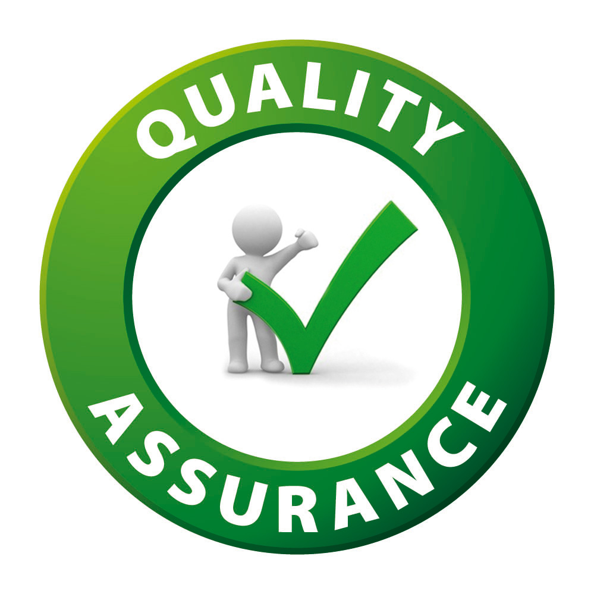
What is Quality Assurance?
Definition of QA: QA is a set of activities ensuring development processes are sufficient to meet quality requirements. It is process-oriented, not product-oriented.
Focus on Process Improvement: QA integrates across the SDLC with methods like peer reviews, code standards, and documentation to enhance process quality from the start.
Proactive Nature: QA prevents defects by auditing processes, conducting training, and enforcing standards before coding starts.
QA vs. Testing: QA ensures process integrity; testing confirms the final product meets specifications.
Importance in Low-Code Context: QA frameworks must adapt to low-code tools to balance speed with quality, accounting for visual tools and non-traditional developers.

Slide 5
Why Does Quality Matter?
User Satisfaction: Bug-free software enhances experience, drives retention, and strengthens brand perception.
Cost Reduction: Fixing defects post-release can cost up to 100x more than prevention; early QA reduces long-term expenses.
Business Continuity: Stable systems prevent downtime in critical operations, ensuring service availability and trust.
Security and Compliance: Proactive QA detects vulnerabilities early and helps comply with standards like GDPR and HIPAA.
Competitive Advantage: High-quality software enables differentiation and customer loyalty in competitive markets, including low-code environments.

Slide 6
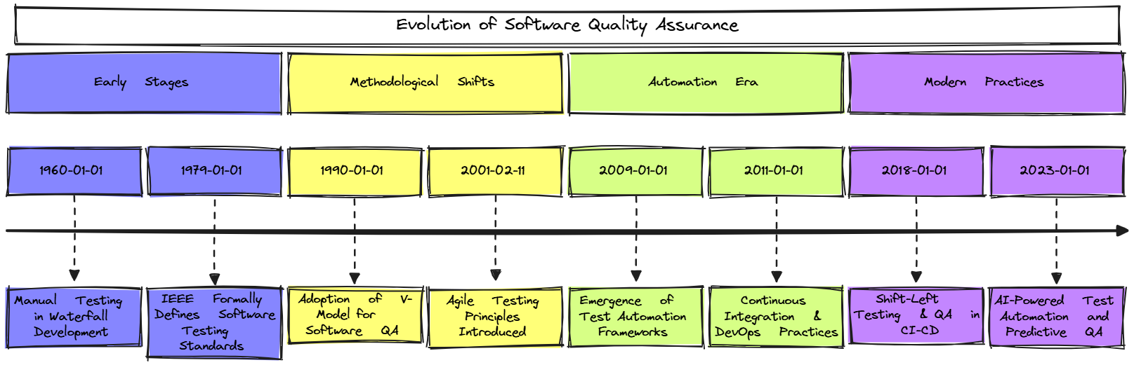
Evolution of Quality Assurance
Quality Assurance has evolved alongside software development practices from manual inspection to integrated, automated approaches supporting Agile, DevOps, and Low-Code environments.
Here is the timeline diagram of the Evolution of Software Quality Assurance.

Slide 7
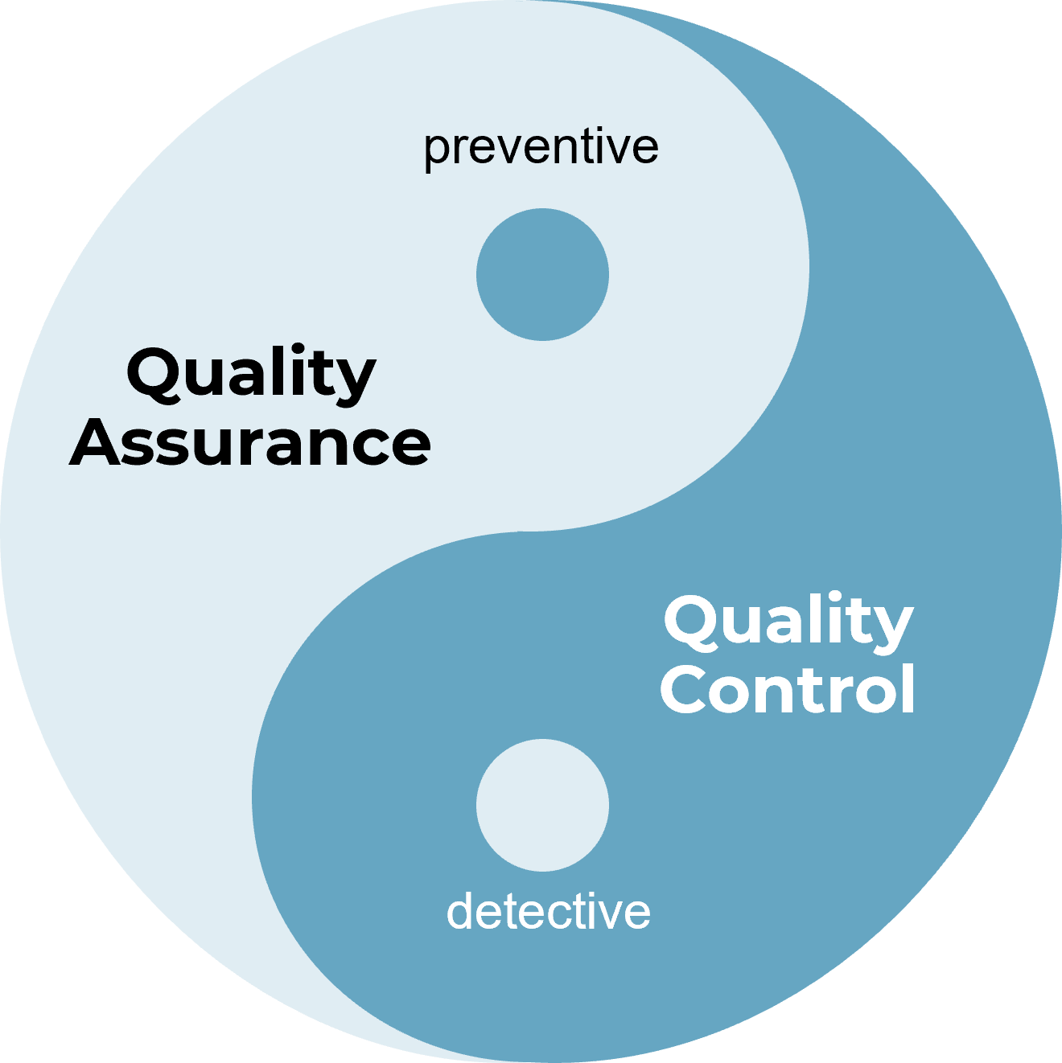
Quality Assurance vs. Quality Control
Definition of QA: QA is process-oriented, focused on establishing and following development standards to prevent defects.
Definition of QC: QC is product-oriented, involving reviews, inspections, and testing to detect and correct defects.
Main Differences: QA focuses on process, prevention and is continuous during development; QC focuses on product, detection and occurs post-development.
Tools and Responsibility: QA uses audits, checklists, and training; QC relies on testing and reviews, often executed by dedicated QA teams.
QA and QC Together: QA ensures the process builds quality in; QC confirms the product meets those standards before release.

Slide 8
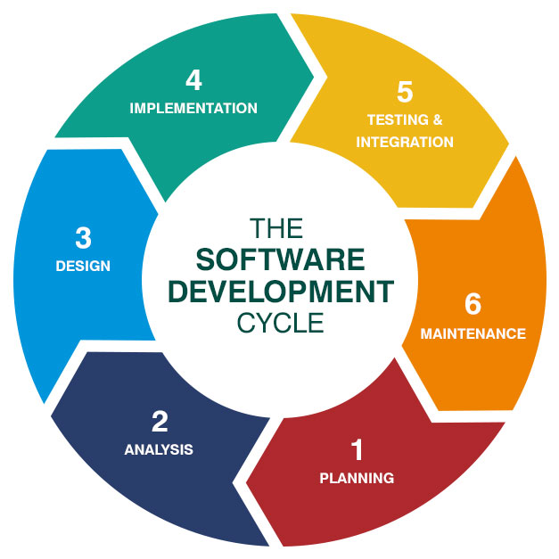
QA in the Software Development Lifecycle (SDLC)
QA throughout the SDLC: QA is embedded in all SDLC phases, from requirements to maintenance, emphasizing early defect prevention and process integrity.
Requirements Phase: Reviews, ambiguity analysis, and definition of clear acceptance criteria ensure quality from the outset.
Design & Development: Design walkthroughs, code standards, static analysis, and pair programming integrate QA into the build process.
Testing & Deployment: Includes test case creation, test automation, production readiness, and release validation.
Maintenance & Low-Code: This covers regression testing, issue tracking, and in low-code, visual workflow validation and automated QA integration.

Slide 9
Understanding QA, QC, and Software Testing

Slide 10
Difference Between QA, QC, and Testing
Quality Assurance (QA)
Quality Control (QC)
Software Testing
Focuses on process and standards; aims to prevent defects via audits, training, and process improvements throughout the SDLC.
Ensures final product quality by detecting and fixing defects through reviews, walkthroughs, and test result analysis before release.
Involves executing software manually or automatically to identify bugs and verify functionality during and after development.
Summary Comparison: QA is preventive and process-oriented; QC and Testing are detective and product-oriented with respective roles across the SDLC.
Collaborative Nature: QA establishes processes, QC ensures adherence, and Testing validates functionality—each is complementary, not interchangeable.

Slide 11
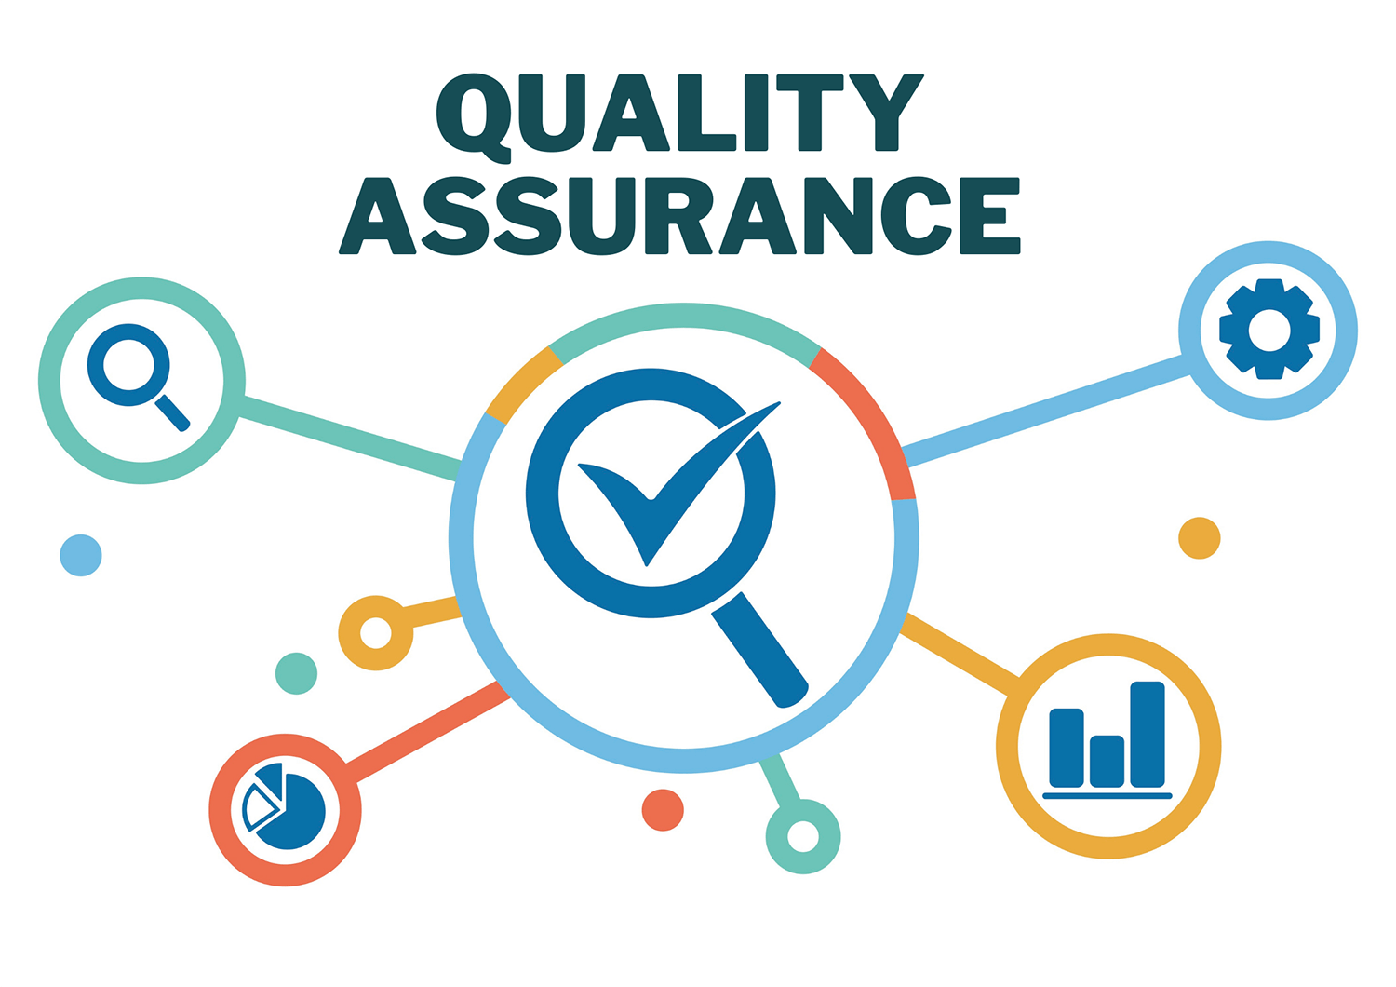
Quality Assurance (QA) Responsibilities
Define Quality Standards and Processes: Establish best practices and guidelines; ensure uniformity in coding and workflows across all teams.
Process Monitoring and Improvement: Conduct audits and reviews; refine workflows to eliminate inefficiencies and bottlenecks.
Collaboration and Communication: Coordinate with cross-functional teams to ensure alignment and clarity on quality expectations.
Documentation and Training: Maintain QA documentation and provide team-wide training on tools, standards, and compliance.
Tool Selection and Integration: Advocate for and implement tools that enhance QA effectiveness, such as automation and tracking systems.
Risk Management: Identify potential quality risks early; guide mitigation through data and quality metrics.
Support Continuous Improvement: Leverage feedback loops and lessons learned to refine quality culture and development practices.

Slide 12

Quality Control (QC) Responsibilities
Product Verification and Validation: Assess deliverables against all requirements to ensure final outputs align with user and stakeholder expectations.
Conducting Reviews and Inspections: Perform structured evaluations of code, UI, and documentation to identify early-stage defects.
Test Execution and Defect Reporting: Run test cases and document bugs using tracking tools to maintain accountability and traceability.
Regression Testing: Verify previously working features still function after changes, ensuring software stability.
Metrics Collection and Reporting: Track defect density, severity, and test coverage to inform quality trends and decision-making.
Supporting Release Decisions: Offer objective go/no-go inputs based on test results and quality assessments.
Collaboration with QA and Development: Work alongside QA and developers to align fixes with requirements and improve future processes.

Slide 13
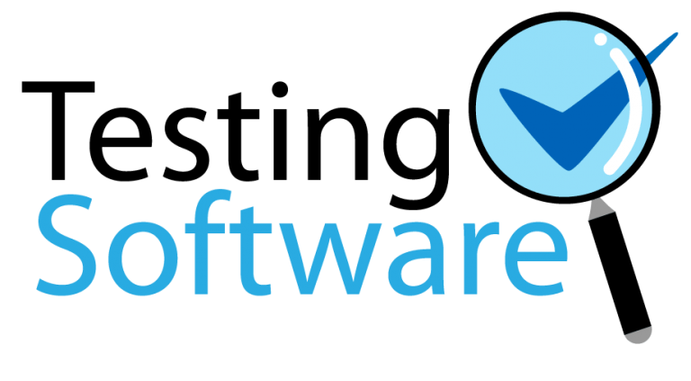
Software Testing Defined
Definition of Software Testing: Executing applications to detect defects and confirm alignment with functional, technical, and user expectations.
Purpose of Testing: Expose bugs early, validate behavior under various conditions, and ensure system reliability and resilience.
Testing Objectives: Enhance quality, reduce failure costs, and build stakeholder confidence in product performance.
Testing Is Not Just Bug Hunting: Covers usability, performance, security, and more—ensures robustness, scalability, and maintainability.
Manual vs. Automated Testing: Manual involves human interactions; automated uses scripts and tools for efficiency and repeatability.
Common Misconceptions: Testing reveals bugs, not guarantees bug-free software; it's a lifecycle activity, not just a phase.

Slide 14

How QA, QC, and Testing Work Together
QA Sets the Foundation: Defines standards and practices; embeds quality into the development process from the beginning.
QC Applies Oversight: Uses inspections, reviews, and metrics to ensure compliance with QA standards and validate outputs.
Testing Executes and Validates: Focuses on running the software to uncover defects and confirm requirements are met.
Complementary Roles: QA prevents defects → QC ensures standards are met → Testing detects issues; all support a feedback loop.
Collaboration is Key: Cross-role communication accelerates bug discovery and resolution, improving product quality.
In Low-Code Environments: QA defines low-code best practices; QC validates visual logic; Testing integrates platform tools with automation.

Slide 15
Types of Software Testing

Slide 16
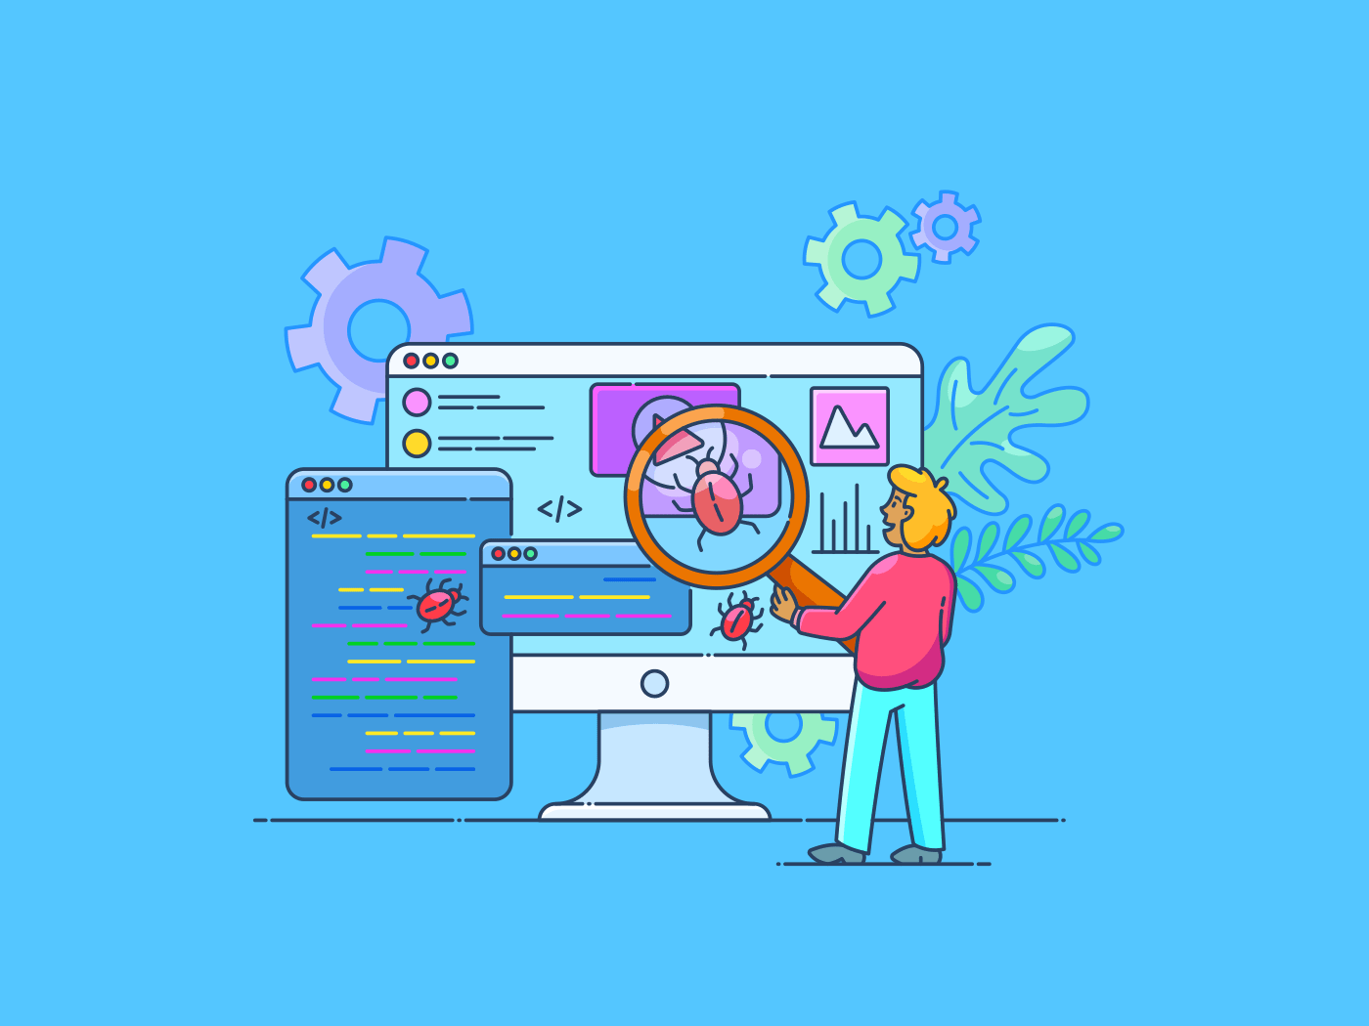
Introduction to Software Testing
What Is Software Testing? A process to verify that software performs as intended, identifying defects, errors, and gaps through execution.
Why Testing Matters: Boosts confidence, prevents production failures, and ensures alignment with user experience and business needs.
Goals of Software Testing: Confirm functionality, assess performance and security, and evaluate usability and compatibility.
Types of Testing Overview: Covers diverse testing forms - manual, automated, functional, non-functional - to ensure complete quality coverage.
Low-Code Considerations: Validates workflows, connectors, and logic in visual tools; addresses high-velocity development challenges.

Slide 17
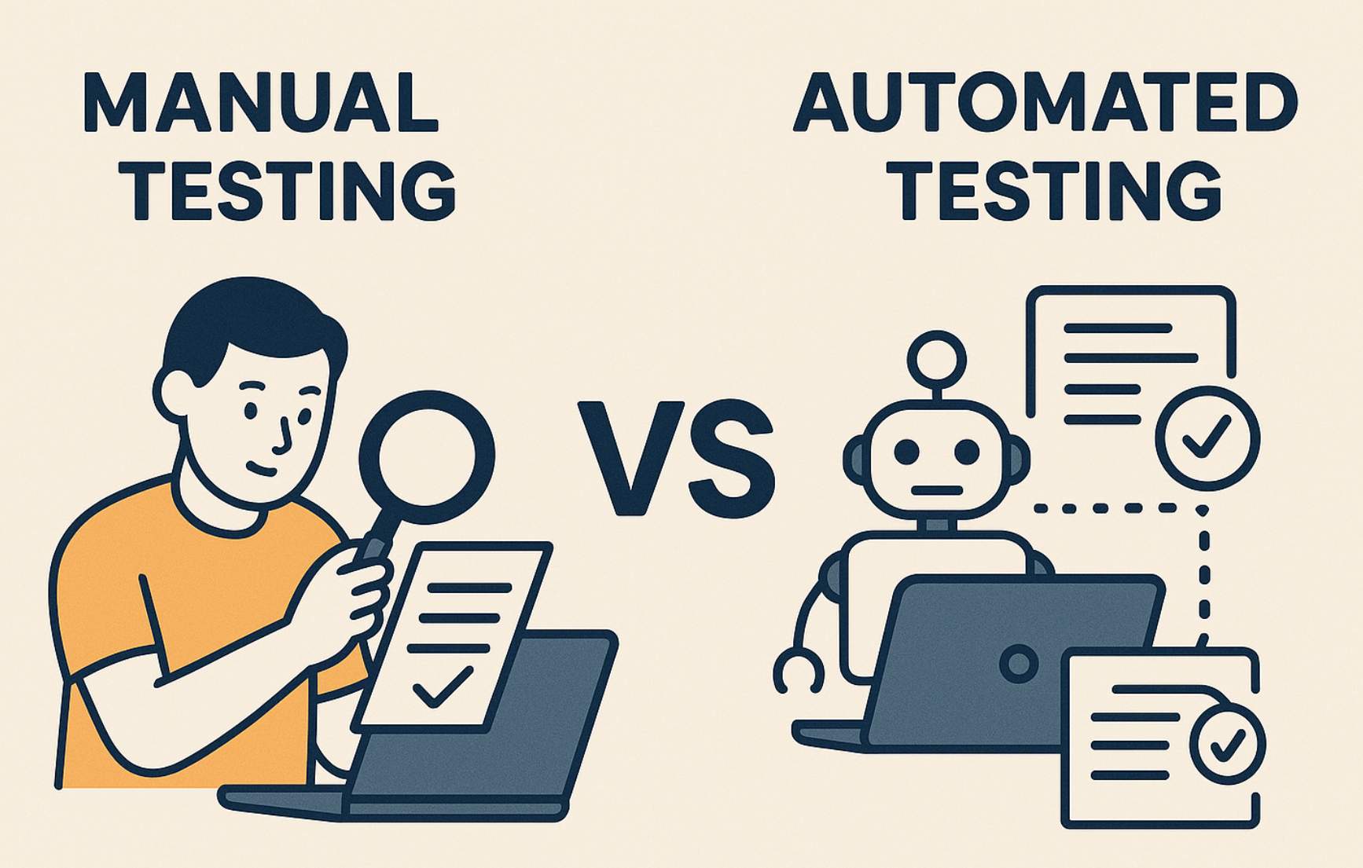
Manual vs. Automated Testing
Manual Testing: Human execution of test cases, ideal for UI evaluations, exploratory scenarios, and short-term needs.
Pros: Intuitive and adaptable for new test cases; no need for scripting or tool knowledge.
Cons: Slow, error-prone, and unsuitable for repetitive regression tasks.
Automated Testing: Uses scripts/tools for high-volume, consistent test runs—best for regression and CI/CD pipelines.
Pros: Fast, repeatable, scalable; integrates well with modern DevOps workflows.
Cons: Requires setup time, scripting skills, and ongoing maintenance.
Low-Code Context: Manual for prototyping/UI; automation via platform tools like UiPath.

Slide 18
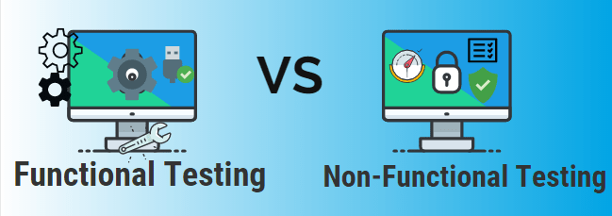
Functional vs. Non-Functional Testing
Functional Testing: Validates what the system does by checking that features operate according to requirements and business rules.
Types: Includes Unit, Integration, System, and Acceptance Testing—each verifying inputs, outputs, and workflows.
Example: Checking if the 'Submit' button correctly saves form data to the database.
Non-Functional Testing: Assesses how the system performs under various conditions to ensure usability, security, and scalability.
Types: Covers Performance, Load, Usability, Security, and Compatibility Testing.
Example: Evaluating if the system responds within 2 seconds under peak load conditions.

Slide 19

Unit Testing
What Is Unit Testing? Verifies individual functions or components in isolation to catch bugs early and confirm logic correctness.
Who Performs It? Primarily developers; typically executed during or right after coding.
Why It’s Important: Ensures correctness before integration, supports refactoring, and speeds up issue identification.
Characteristics: Fast, automated, and isolated from external systems like databases or APIs.
Tools Used: JUnit, NUnit, PyTest for traditional; UiPath Test Suite, Power Apps Test Engine for low-code platforms.
Low-Code Context: Tests target visual components, logic rules, and flow actions—critical for apps built by citizen developers.

Slide 20
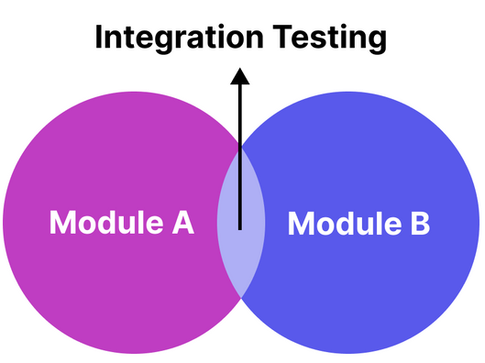
Integration Testing
What Is Integration Testing? Tests the interaction of components and data exchange between modules, verifying logic, flow, and system coherence.
Why It’s Important: Detects failures in module interactions, API communications, and timing logic that unit tests miss.
Who Performs It? Joint effort between developers and QA testers; suitable for both manual and automated testing.
Types of Integration Testing: Big Bang (all at once) and Incremental (step-by-step: top-down, bottom-up, sandwich).
Tools Used: JUnit, TestNG, Postman for APIs; Power Automate, UiPath, and Dataverse tools for low-code environments.
Notes:
Low-Code Context:
Integration testing ensures that flows, connectors, and data sources work together.
For example: testing that a form submission triggers an approval flow that correctly updates a record in Dataverse.

Slide 21

Usability Testing
What Is Usability Testing? Non-functional testing that evaluates how intuitive and user-friendly an interface is for real users.
Objectives: Confirm users can complete tasks easily, interface is accessible, and layout supports smooth navigation.
When It's Performed: Conducted during prototyping and pre-release stages for early feedback and issue identification.
Key Techniques: Includes observation, task-based testing, surveys, interviews, and think-aloud protocols.
Notes:
Tools Used:
UsabilityHub, Maze, Lookback, Figma prototypes
Built-in session recording or heatmaps (for web apps)
Low-Code Context:
Important when citizen developers build apps that may not follow UX best practices.
Usability testing helps ensure that forms, flows, and dashboards are intuitive.
Also evaluates how responsive and accessible the app is on various devices.

Slide 22
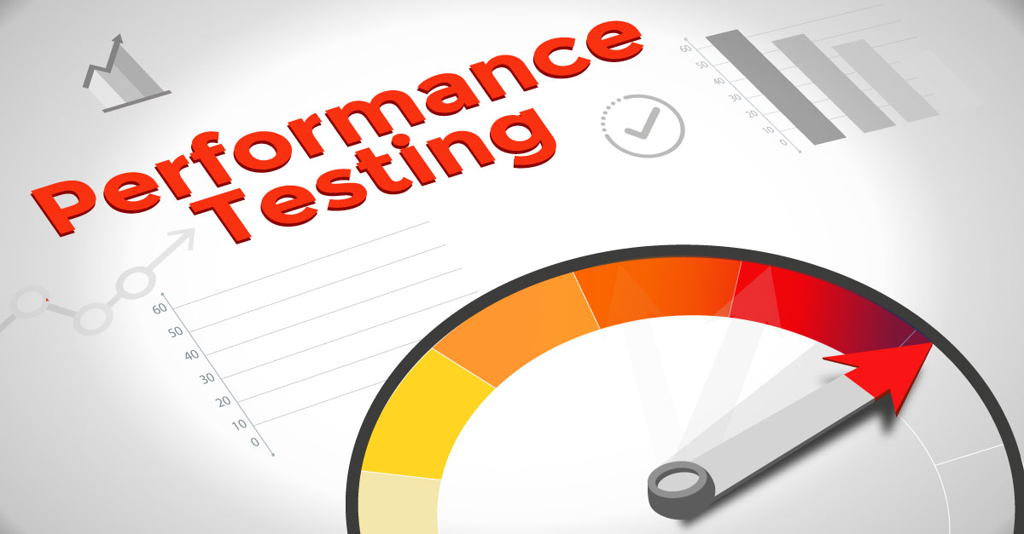
Performance Testing
What Is Performance Testing? Evaluates how fast and stable a system is under normal and extreme workloads, focusing on speed, scalability, and resource usage.
Objectives: Measure response time, throughput, CPU/memory usage, and identify system bottlenecks early.
Subtypes of Testing: Load (normal), Stress (beyond limits), Spike (sudden traffic), Endurance (long-term behavior).
Why It’s Important: Maintains responsiveness under pressure, prevents crashes, and supports SLA compliance.
Notes:
Tools Used:
JMeter, LoadRunner, BlazeMeter, Locust
Power Platform and UiPath Test Suite: May require external tools to simulate heavy load conditions in low-code apps.
Low-Code Context:
Performance testing helps validate:
Flow runtime efficiency (e.g., Power Automate/UiPath)
Load times of apps built in Power Apps
Connector reliability under multiple concurrent transactions

Slide 23

Security Testing
What Is Security Testing? Non-functional testing to validate confidentiality, integrity, and availability; uncovers vulnerabilities like data leaks and weak authentication.
Why It’s Important: Prevents breaches and system compromise, ensures compliance (OWASP, GDPR, HIPAA), and boosts user trust.
Key Areas of Focus: Authentication, authorization, data encryption, input validation, and session management.
Common Testing Techniques: Penetration testing, vulnerability scanning, static/dynamic code analysis, and audits.
Notes:
Tools Used:
OWASP ZAP, Burp Suite, Nessus, SonarQube
For low-code: verify platform-level controls (e.g., role-based access in Power Apps, secure credential storage in UiPath)
Low-Code Context:
While low-code platforms often have built-in security features, they still require:
Validation of data exposure rules
Proper access control configuration
Secure API and connector usage

Slide 24
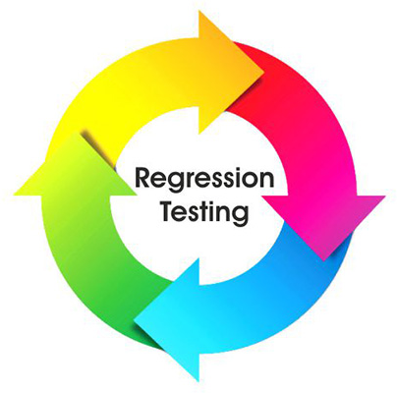
Regression Testing
What Is Regression Testing? Re-tests existing functionality to ensure new changes don’t introduce unintended side effects.
Why It’s Important: Prevents reintroduced bugs, protects software stability, and supports continuous delivery models like Agile and DevOps.
When to Perform It: After fixes, enhancements, refactors, or config changes—especially before deployments or during sprints.
Manual vs. Automated: Automation is ideal for regression; suites can be run after each build to verify system integrity.
Notes:
Tools Used:
Selenium, TestNG, JUnit
UiPath Test Suite, Power Apps Test Studio (for low-code flows and app logic)
Low-Code Context:
With rapid deployments, regression testing ensures that visual changes or updated connectors don’t impact other parts of the application.
Automated tools can simulate end-to-end business scenarios built in platforms like Power Platform or UiPath.

Slide 25
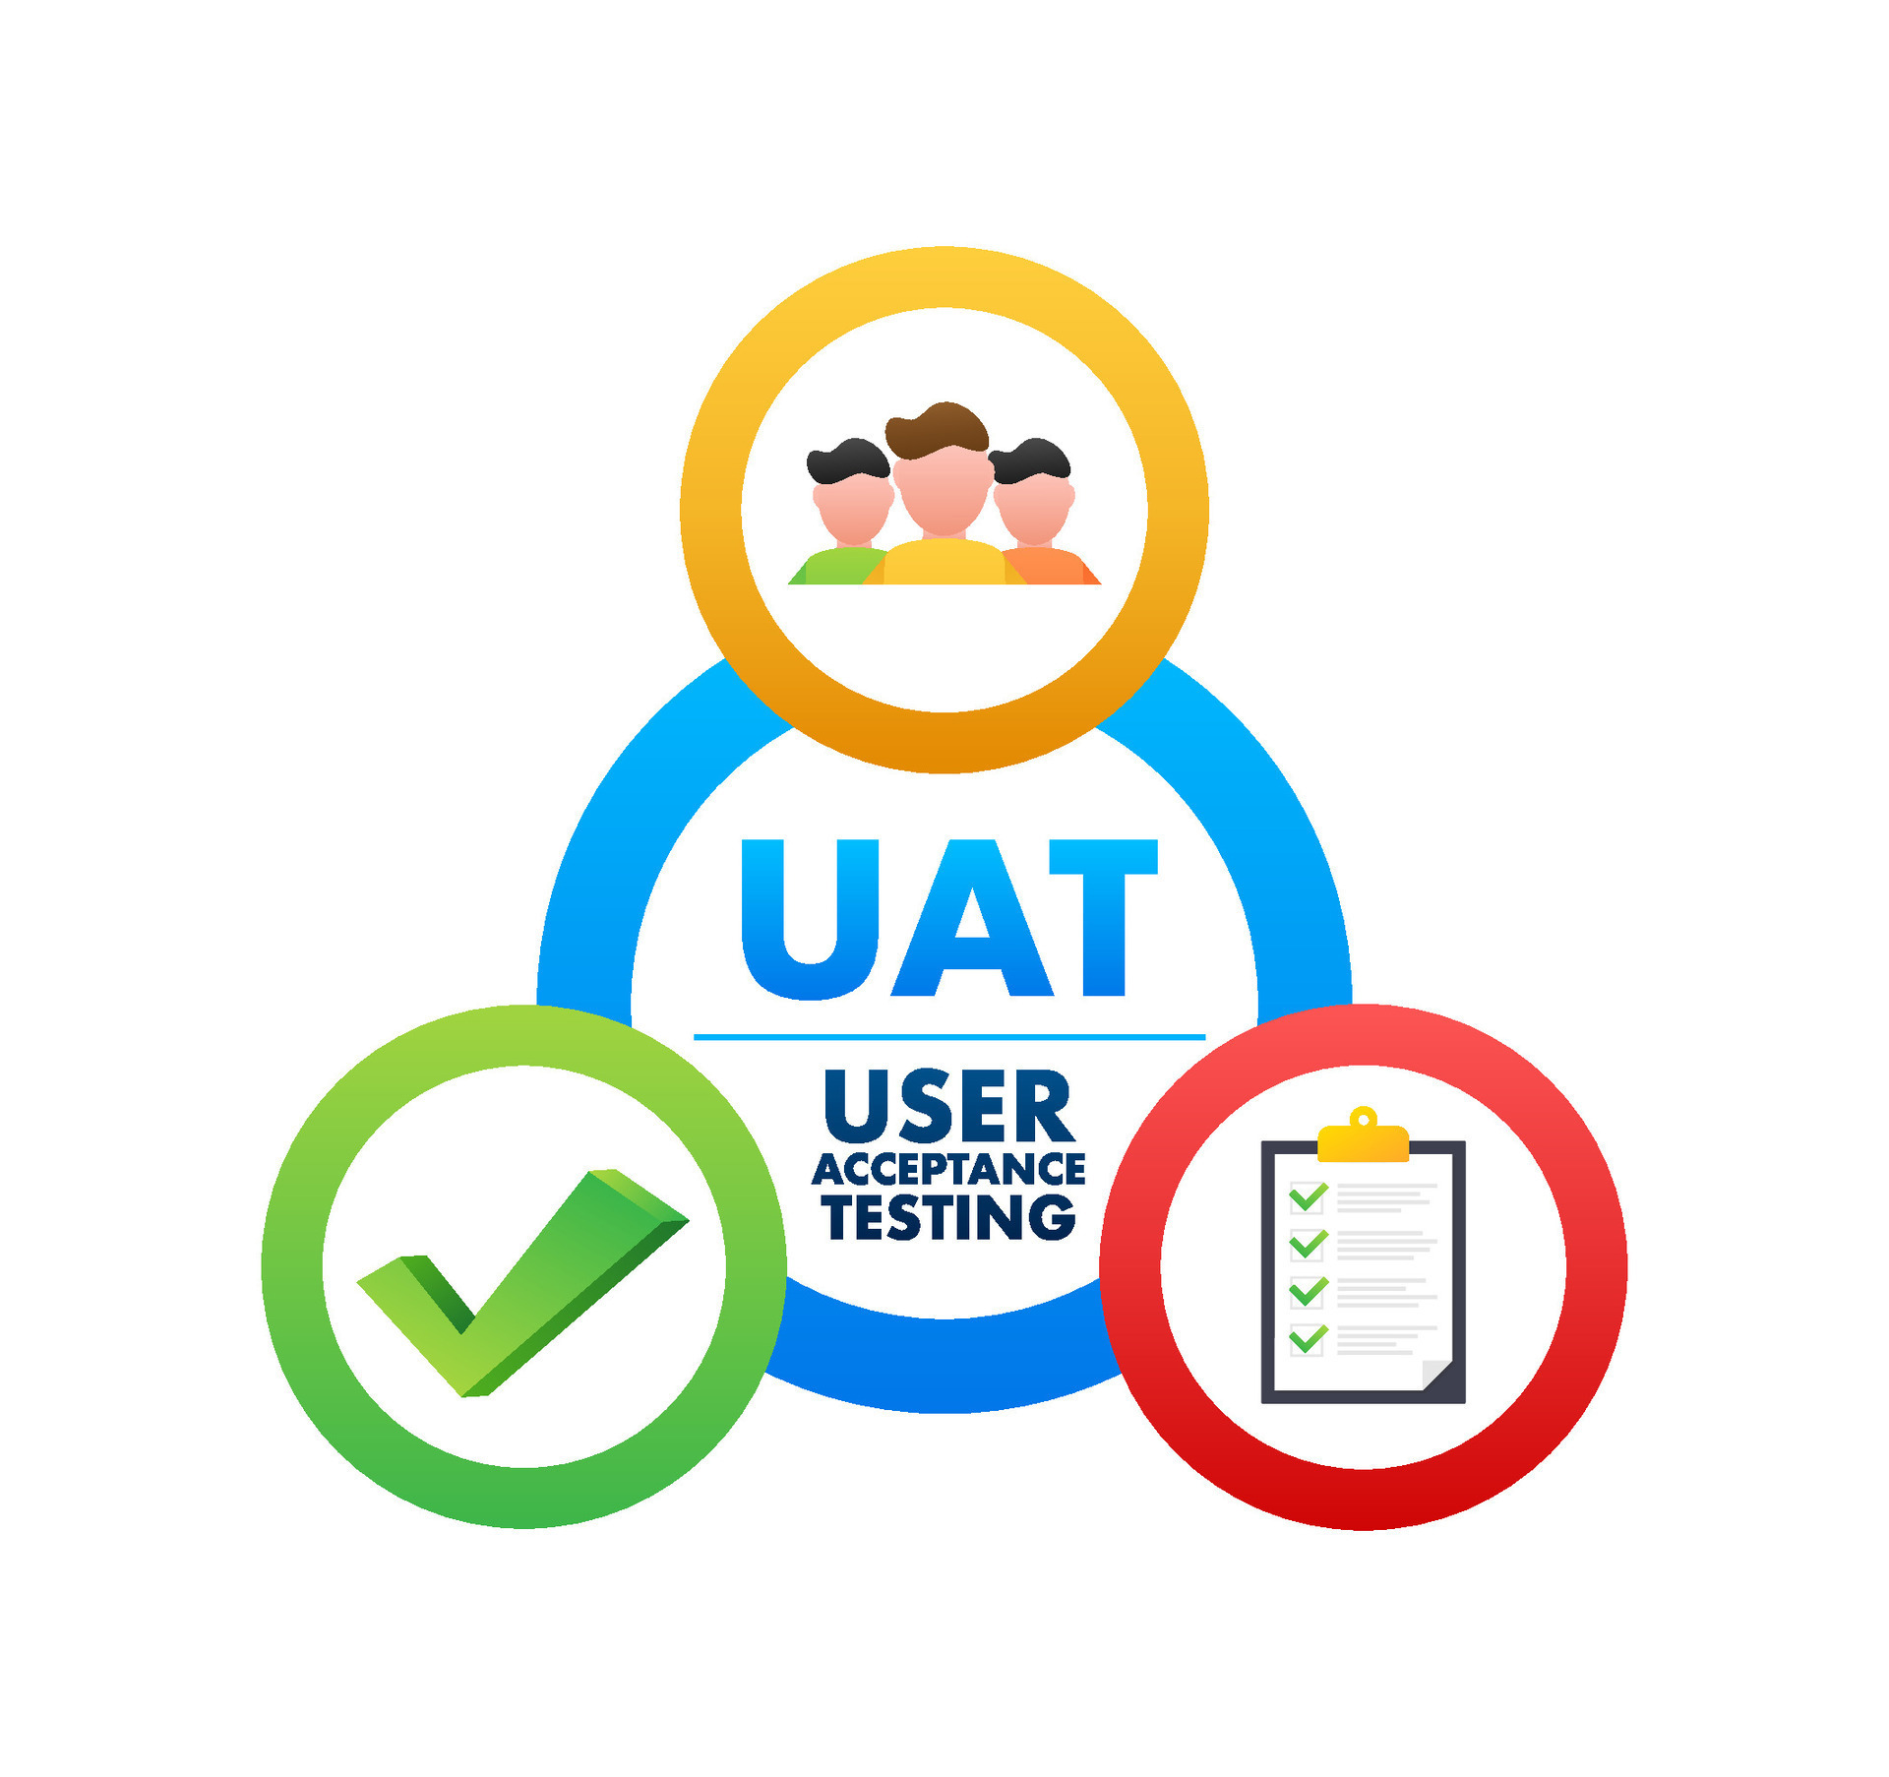
User Acceptance Testing
What Is UAT? Testing by end users to ensure the software meets business requirements and is ready for production use.
Purpose of UAT: Validate real-world functionality, confirm user workflows, and catch any gaps missed during earlier testing phases.
Who Performs It? Business users, product owners, or clients—not QA engineers—guided by use cases or criteria.
When It Occurs: Executed after system and regression testing, just before production deployment.
Typical Activities: Performing business tasks, offering feedback, and formally accepting or rejecting the release.
Notes:
Low-Code Context:
In low-code platforms, UAT is crucial because apps are often developed by or for business teams.
Helps confirm that the visual logic, data flows, and UI components truly reflect user needs.
Enables quick iteration based on user feedback before go-live.

Slide 26
QA Tools

Slide 27
Popular QA Tools
Test Management Tools: TestRail, Zephyr, qTest – organize test plans, cases, and track execution across teams.
Bug/Defect Tracking Tools: Jira, Bugzilla, Mantis – manage bug lifecycles with integration into source control and CI/CD.
Automation Testing Tools: Selenium, Cypress, Playwright – enable web automation; Selenium is a leading UI testing framework.
Performance Testing Tools: JMeter, LoadRunner, BlazeMeter – simulate user load to assess speed, stability, and bottlenecks.
Security Testing Tools: OWASP ZAP, Burp Suite, SonarQube – detect vulnerabilities, enforce security compliance.

Slide 28
Low-Code and No-Code Testing
UiPath Test Suite: test automation for workflows and UI elements
Power Platform Test Studio: record-and-playback tests for Power Apps
OutSystems Test Framework, Mendix ATS, and other platform-native solutions

Slide 29
Lab Exercise Overview
In this collaborative lab, students will analyze real-world software scenarios and determine the most appropriate type of software testing for each case.
Through group discussion and short written responses, they’ll build foundational knowledge in identifying and applying various testing methods.

Slide 30
Any questions?

